Slide 1
Deaths of Despair, deaths from the virus, and the US healthcare system
Angus Deaton, BFI, April 9th, 2020

Slide 2
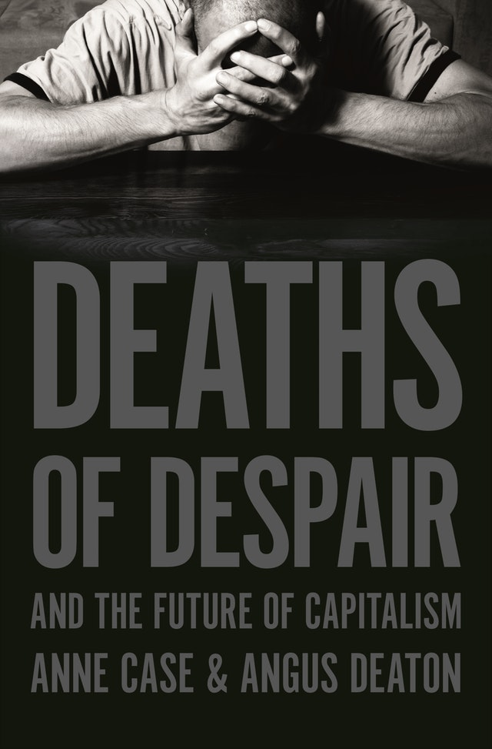
Princeton University Press
March 17, 2020!
Amazon is slow. Support your
local independent seller.

Slide 3
Background
Our book is about “Deaths of despair”
Suicides, drug overdoses, and alcoholic liver diseases
158,000 in 2018
65, 000 in 1995
The increase is almost exclusively among Americans without a four year college degree
Both men and women
Until recently, predominantly white
We trace it back to a faltering labor market for less-educated workers
Fewer jobs
Lower earnings
Familiar causes: globalization and automation
Less familiar: the rising costs of an ”absurd and oppressive” healthcare system

Slide 4
Analogy with deaths from coronavirus?
The economy has been deliberately crashed: many job losses
Likely disproportionately among the less educated
Will the crashing of the economy cause an increase in deaths of despair?
Perhaps worse than the disease itself?
President Donald Trump
“WE CANNOT LET THE CURE BE WORSE THAN THE PROBLEM ITSELF”
“You're going to lose more people by putting a country into a massive recession or depression,”
“You’re going to lose people. You’re going to have suicides by the thousands.”
Suicides maybe, but overall mortality is likely to decline, not increase
Many papers, many places, many times find that all-cause mortality falls in recessions
Although suicides do increase

Slide 5
Evidence and arguments
Deaths of despair are a slow disintegration of working-class lives
Not affected by the business-cycle
DoD rose before the financial crisis, during the financial crisis and after the financial crisis
More generally all-cause mortality rates have fallen
In Greece and Spain in financial crisis
In Great Depression, mortality rates local record lows
Why?
Accidents of all sorts are low: highway, construction etc. (Seeing this in NYC now)
Alcohol consumption goes down, esp. binge drinking
Pollution down, important for infant mortality
Elder care in the US, low wage workers can earn more elsewhere in the boom
Suicides go up, but are only 2 percent of total deaths

Slide 6
Where is the Great Recession?
Those without a BA were a constant proportion ( ~67%) of this population over this period

Slide 7
Maybe this recession is different?
Low wage workers may not flock to work in elder care homes now
Suicide rates are higher in more isolated places: Rocky Mountain suicide belt
Social isolation may be like this
Lots of stories of domestic abuse: murders?
BUT suicide rates typically lower in wartime
Social solidarity
Some leaders may be able to forge solidarity now
The Queen

Slide 8
Healthcare industry
Background from book

Slide 9
Uniquely expensive in the US
18 percent of GDP v next highest is 12 in Switzerland, with four years more LE
Who pays?
About a quarter by employers for employees
About a quarter by individuals directly
About half by Federal and State governments, most of last for Medicaid
Employer plans in 2019 $20k for family $10k for individual
For low-wage workers, this is not feasible: like a poll-tax
Large firms no longer employ janitors, drivers, call-center operators, food service workers, security
Outsourced or gig workers: much worse jobs
State governments cut state universities to pay for Medicaid; share 20% to 30% in a decade
Until COVID, future Federal deficits are almost entirely for healthcare

Slide 10
Absurd and oppressive monopolies
Adam Smith: here the protection that government gives to maintain the wealth of the industry
Five lobbyists for each member of Congress
Opioid manufacturers targeted communities of despair
And made billions from addiction and overdoses
While Congress protected them by changing laws, and muzzling DEA
J & J subsidiary growing opium in Tasmania
No other country allows this
Surprise medical bills, prescription drug benefits, lack of CBA for procedures, drugs and devices, no price controls, automatic Medicare payment for drugs approved by FDA, industry finances FDA, and influences trials and approvals
Hospitals merge with little attention from anti-trust regulators
Monopoly in local markets, monopsony against nurses

Slide 11
Healthcare and covid19
Two possibilities: healthcare the HERO, healthcare the VILLAIN
Doctors and nurses are seen as those who saved us
Pharma will come up with a vaccine and drugs, and make them widely available
(Lobbyists fought affordability provision in coronavirus bill: $3.1 bn for development of drugs and vaccines)
Hospitals will co-ordinate, share equipment, beds, and staff: happening already in NY
Testing free, copays and deductibles waived by insurers
Deaths relatively small, and full recovery for others
Opposite of above
Drugs expensive and rationed by price: pharma overreaches
No vaccine for many years
Many thousands left with very large bills that they cannot pay, that destroy credit for rest of life
Large surprise medical bills, even when insurers waive copays and deductibles
Anger penetrates the protective cordon in Washington and we get reform

Slide 12
COVID19 and inequality
Inequality of income: unequal financial burden
Inequality of health outcomes: different groups die more or get sick more

Slide 13
Clear immediate effect
Less-educated Americans are either:
Essential workers, which puts their lives at risk (Subway, grocery stores, etc.)
Non-essential, which puts their livelihood at risk (depending on emergency transfer programs)
Either way, health inequality by education, and income inequality (by education or just income) likely to increase
Already indications that blacks and Hispanics disproportionately affected
Excess mortality rates seem to be roughly proportional to existing mortality rates
Men twice women, pre-existing conditions raise mortality
Morbidity higher among the less-educated
Social distancing is harder for poorer people
Close to impossible for poor people in India, Africa, etc
High rates of baseline morbidity
Lockdowns likely to remove livelihoods without improving health, esp with poor healthcare systems

Slide 14
Less clear long run
Globalization is likely to be in retreat (already was)
We’ve been getting higher incomes by incurring risks
Some off-shore jobs will return
More diverse sources of key materials: medicines
Lower income inequality and lower average incomes
Healthcare reform to something else (many possible models)
Remove burden on less-educated jobs and increase supply of low-education jobs
Reduce earnings of industry professionals in pharma, hospital management, device manufacturers, and physicians
Both together could substantially reduce income inequality
Reduce deaths of despair among less-educated Americans

Slide 15
Supplementary slides

Slide 19
US white non-Hispanics ages 50-54

Slide 21
Drug, alcohol and suicide mortality by year of birth

Slide 22
Drug, alcohol and suicide mortality rates, white non-Hispanics

Slide 23
US Deaths of despair
Alcoholic liver disease: in every US state, age-adjusted mortality rates rose for white non-Hispanic prime-aged adults (ages 25-64) from (1999-2000) to (2017-2018)
Suicide: in every state, suicide rates rose for prime-aged WNH from
(1999-2000) to (2017-2018)
Accidental or intent undetermined drug poisoning: mortality rates increased in every state from (1999-2000) to (2017-2018) – but classifying the underlying drugs is shooting at a moving target -- Prescription opioids, heroin, fentanyl

Slide 24
Wages and labor market attachment, men ages 25-54, less than a four-year degree

Slide 25
Life expectancy and health expenditure per capita ($2010 international dollars)
1970-2015

Slide 26
Life expectancy and health expenditure per capita ($2010 international dollars)
1970-2015

Slide 27
Life expectancy and health expenditure per capita ($2010 international dollars)
1970-2015

Slide 28
Life expectancy and health expenditure per capita ($2010 international dollars)
1970-2015

Slide 29
Life expectancy and health expenditure per capita ($2010 international dollars)
1970-2015

Slide 30
Life expectancy and health expenditure per capita ($2010 international dollars)
1970-2015

Slide 31
Life expectancy and health expenditure per capita ($2010 international dollars)
1970-2015

Slide 32
Life expectancy and health expenditure per capita ($2010 international dollars)
1970-2015

Slide 33
The trillion dollar protection racket
17.8 percent of US GDP in 2018
Switzerland is next highest at 12.4 percent
Swiss lives are five years longer than American lives
Difference in spending is 5.4 percent, or more than a trillion dollars a year
More than $8,300 for each US household
This is just the waste
Americans pay more for most health services and products, and use a lot more of low value high cost procedures, drugs, and machines

Slide 35
Fraction white non-Hispanics married, by age and education

Slide 36
We argue that, in many respects, what has happened to white working class Americans mirrors what happened to African Americans beginning in the 1960s, and can be seen as another chapter in the saga of American labor.
Many of the same arguments made about “black culture,” going back to the Moynihan Report [“at the center of the tangle of pathology is the weakness of the family structure”] are being made today about the “white working class culture”
Charles Murray: “white males of the 2000s were less industrious than they had been 20, 30 or 50 years ago … the decay in industriousness occurred overwhelmingly in [white working-class] Fishtown”

Slide 37
Mortality rates, ages 45-54, by race

